Slide 1

C# Developer Tod vachev
Codestars.com

Slide 2
Objectives
About the course
Who is it for?
What you will learn
Software needed
Variable and Data type
The Console
Operators and Expressions conditional statements
Loops
Methods
Arrays and Lists
String Processing
Exceptions
Object Oriented Programming Basics
Pillars of Object-Oriented Programming

Slide 3
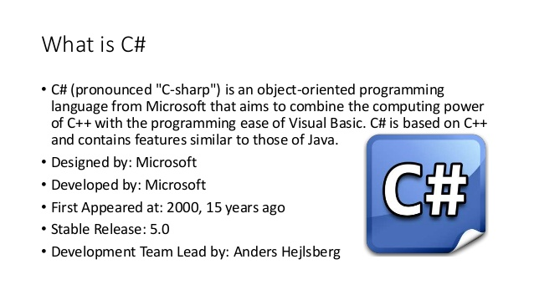
Introduction
What is C#
It is an object-oriented programming language created by Microsoft that runs on the .NET Framework.
For more https://www.w3schools.com/cs/cs_intro.asp

Slide 4
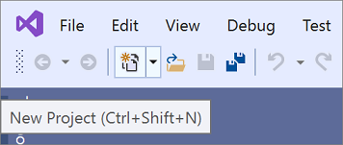
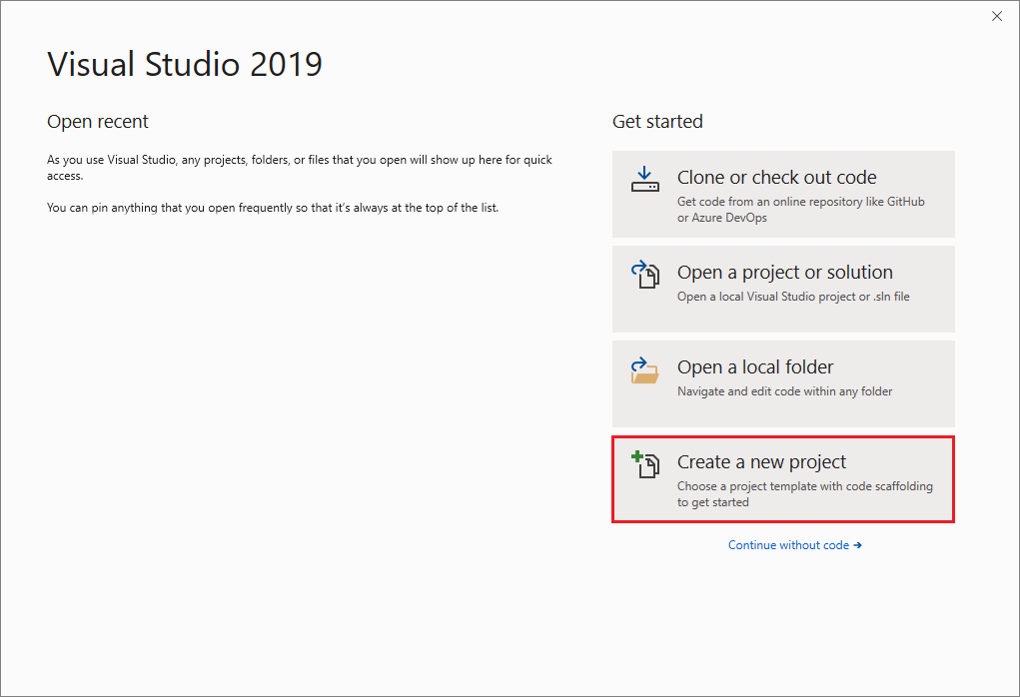
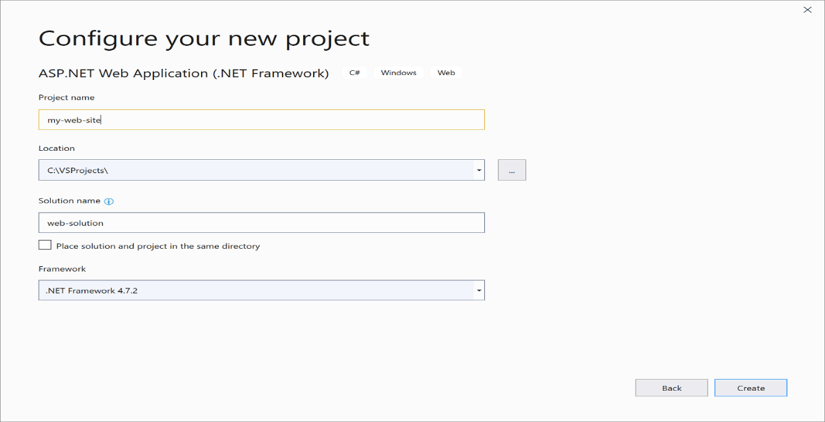
Creating a Project in Visual Studio

Slide 5
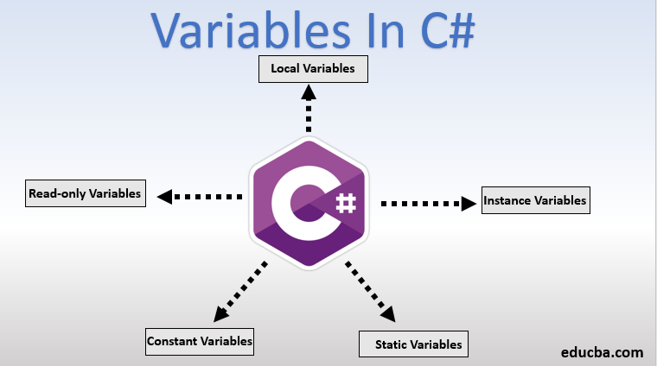
Variable
A variable is name given to a storage area that is used to store values of various data types
Each variable in C# needs to have a specific type, which determines the size and layout of the variable’s memory

Slide 6
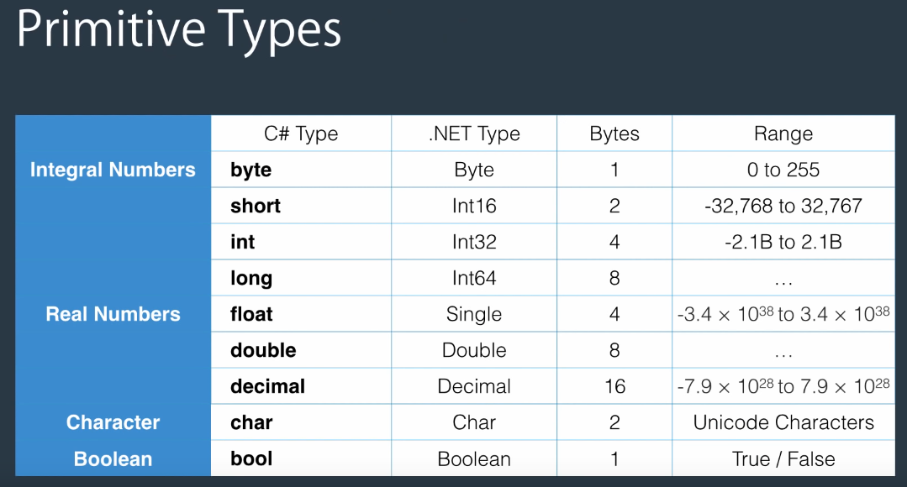
Primitive Data Type
The primitive data types are number, string, Boolean, float etc.

Slide 7
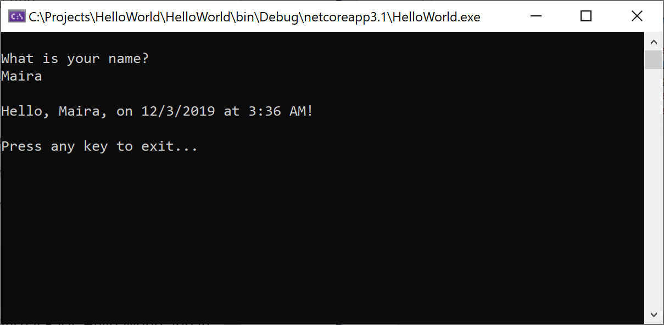
The Console
What Is Console Application
Console application (app) is a program developed in Visual Studio which accepts input parameter, calls the required service, runs business logic and sends output to the console, this console is known as the command prompt.

Slide 8
Console Class in C#
Properties of Console Class in C#:
Property | Description
Title | Specifies the title of the console application
Background color | Specifies the background color of the text
Foreground color | Specifies the foreground color of the text
Cursor size | Specifies the height of the cursor in the console window “1 to 100”
What is Console Class in C#
In order to implement the user interface in console applications, Microsoft provided us with a class called Console. The Console class is available in the “System” namespace. This Console class provides some methods and properties using which we can implement the user interface in a console application.
Methods of Console class in C#:
Method | Description
Clear() | To clear the screen
Beep() | Play a beep sound using a PC speaker at runtime
Resetcolor() | Reset the background and foreground color to its default state
Write(“string”) | Display the specified message on the console window
WriteLine(“string”) | Same as the write method but automatically moves the cursor to the next line after printing the message.
Write(variable) | Displays the value of the given variable
WriteLine(variable) | Displays the value of the given variable along with moving the cursor to the next line after printing the value of the variable.
Read() | Read a single character from the keyboard and returns its ASCII value. The Datatype should be int as it returns the ASCII value.
ReadLine() ReadKey() | Reads a string value from the keyboard and returns the entered value only. As it returns the entered string value so the DataType is going to be a string. This method reads a single character from the keyboard and returns that character. The Datatype should be int as it returns the ASCII value. It is a STRUCT Data type which is ConsoleKeyInfo.

